Slide 1
Text Classification
Objective – Predict categories and subcategories

Slide 2
Hypothesis based on Domain Understanding
Expect few medical terminology to be present in the conversation
  Rx, nortryptline etc., were few of the words that were found with a quick review.
  A standard word2vec model will not have the vocabulary for such words. Hence validate if it is better to use plain embeddings rather than word2vec embeddings.
There are two targets – Categories and sub-categories. So start predicting categories and using the same conversation predict sub-categories
There are few sub-categories where there is a one-to-one mapping to the categories. For now we will not consider them in the model building and prediction process.
.

Slide 3
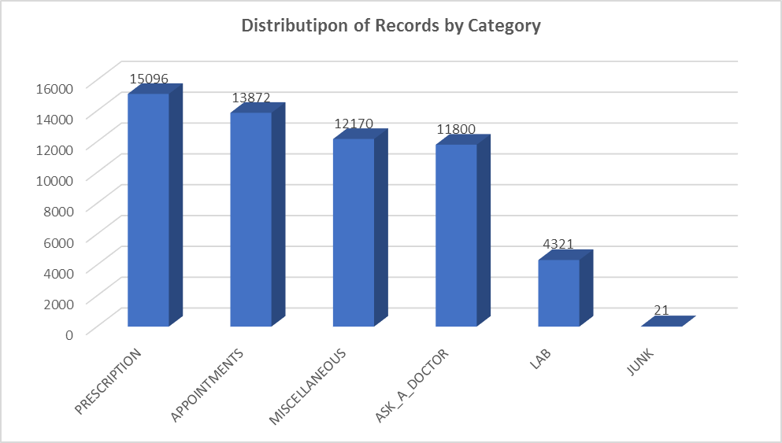
Data analysis
.

Slide 4
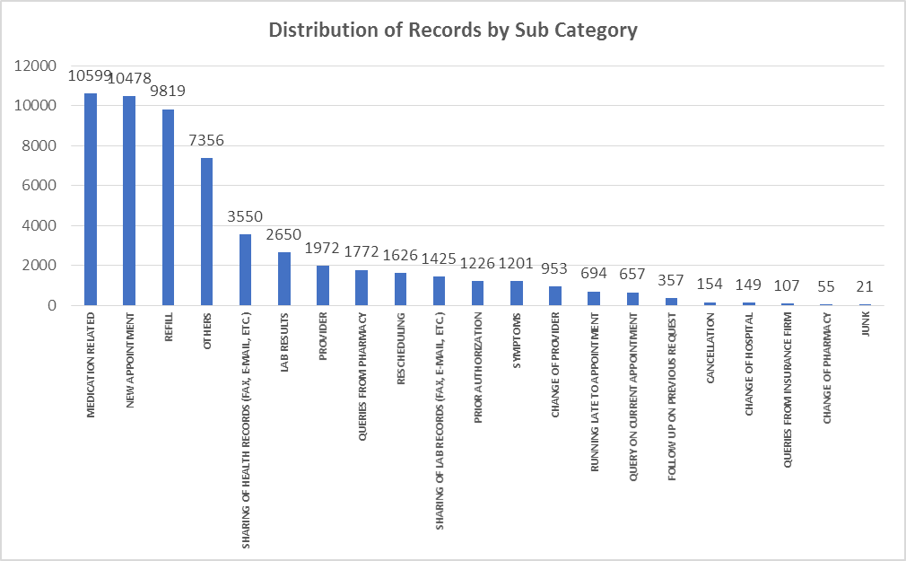
Data analysis
.

Slide 5
Data Pre-processing
Observed | Action
Categories and Sub-categories columns are categorical | Use labelencoder() to convert them into the encoding values Prepare the one hot encoded target using to_categorical()
fileid is a nominal column | Removed this from the dataset
Conversation has varying sentences | Use the tokenizer to build a vocabulary and word index. Need to standardize the sequence length by padding Use embedding layer to map the sentences to a desired size of o/p matrix

Slide 6
Model building
Objective –
  Initially we will use categories as target. Once the best model for the categories is selected, we will use similar model to predict sub-categories as second target using the same train and valid data
  Accuracy will be metric that we will be interested in to track.
Given data was split into train and valid so that predictions and accuracy metrics on valid data are reported once the model is fit.
Tried the below architectures of neural nets on this task in that sequence –
  Simple MLP
  MLP with 2 layers
  LSTM
  CNN
  CNN + LSTM

Slide 7
Analyzing and refining results
Simple MLP with one hidden layer + Plain embeddings : Accuracy of ~75% and had high bias. Was overfitting if we increase the number of epochs.
So added dropout to regularize, used batchnorm to increase the performance and at the same time also increased the number of hidden layers. This increased the accuracy to 77%.
Used glove word2vec instead of plain embeddings on the above model. This decreased the accuracy to 73% ( Suspect words like Rx and other medical terminology might not be part of the glove vocab.)
Decided to use plain embeddings henceforth. Used LSTM model to see if it improves accuracy. The accuracy was around 75% and hence not adding much value.
Decided to use CNN: Tried filters of 64, 256 sizes. Both of them gave similar results of accuracy around 79% on valid dataset.
Decided to use CNN+LSTM: Gave similar results as above.
Conclusion: Using Occams razor, we stuck to using plain CNN model that was giving similar performance.

Slide 8
Analyzing the results
Using the CNN architecture, subcategories is predicted. The accuracy for the subcategories is 70%

